Slide 1
I211 – Information Infrastructure II
Lecture 18

Slide 2
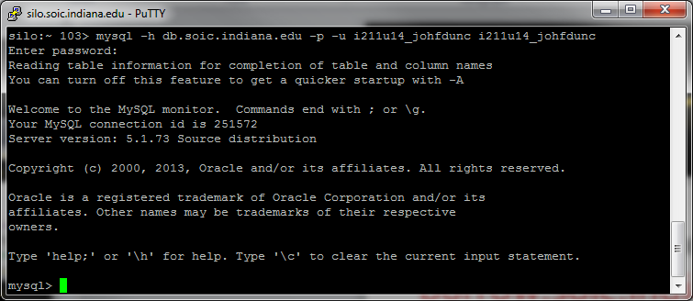
Logging Into MySQL
Use PuTTY to connect to: burrow.soic.indiana.edu
Login as your IU account
At the prompt, type:
mysql -h db.soic.indiana.edu –p –u i211u14_username i211u14_username
(Replace ‘username’ with yours)
Your Password: my+sql=i211u14_username

Slide 3
Python & SQL
We need a way to connect Python scripts with our DB
We will build SQL statements as strings and send them to the DB
The MySQL DB will return the results, either one at a time or all together

Slide 4
Python & SQL
Inserting, updating, or deleting data might take multiple steps
If the server goes down between steps or loses data, we could get invalid, partially correct, or inconsistent data!
This violates our criteria for using a DB, so…

Slide 5
Python & SQL
We want operations to be atomic:
All steps must complete successfully before we consider the operation to be successful
If one step fails, we revert to before the entire operation
A collection of operations that are atomic is called a transaction
We commit a transaction, which makes it permanent (like .close() on a file)

Slide 6
Python & SQL
We’ll be using the sqlite3 module for now, which opens a DB in a file, and returns a connection
We create a cursor in that connection, which is an object that allows us to conduct SQL transactions.
import sqlite3
db_con = sqlite3.connect("my_db.txt")
cursor = db_con.cursor()

Slide 7
Python & SQL
This will create a file that acts as a database (if the file doesn’t already exist)
This will allow us to test SQL in Python without having to use the burrow servers

Slide 8
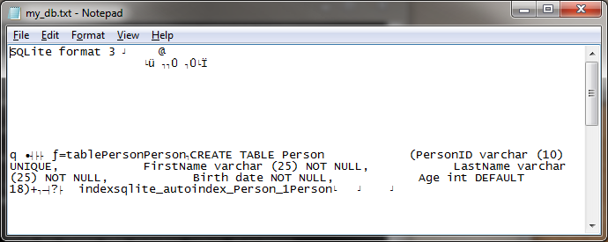
Python & SQL
Let’s create the Person Table:
import sqlite3
def createPersonTable(cursor):
SQL = """CREATE TABLE Person
(PersonID varchar (10) UNIQUE,
FirstName varchar (25) NOT NULL,
LastName varchar (25) NOT NULL,
Birth date NOT NULL,
Age int DEFAULT 18);"""
cursor.execute(SQL)
db_con = sqlite3.connect("my_db.txt")
cursor = db_con.cursor()
createPersonTable(cursor)

Slide 9
Python & SQL
Let’s write a function to insert data
import sqlite3
def insertPerson(cursor, id_num, fname, lname, bdate, age=18):
SQL = "INSERT INTO Person (PersonID, FirstName, LastName, Birth, Age)"
SQL += "VALUES ('" + str(id_num) + "', '" + fname + "', '" + lname + "', '"
SQL += bdate + "', " + str(age) + ");"
cursor.execute(SQL)
db_con = sqlite3.connect("my_db.txt")
cursor = db_con.cursor()
#createPersonTable(cursor)
insertPerson(cursor, 1, 'Jack', 'Sparrow', '1745-04-01', 46)

Slide 10
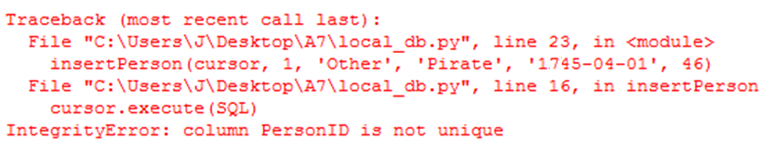
Python & SQL
Sqlite will catch attempts to insert invalid data, just like MySQL did!
insertPerson(cursor, 1, 'Jack', 'Sparrow', '1745-04-01', 46)
insertPerson(cursor, 1, 'Other', 'Pirate', '1745-04-01', 46)

Slide 11
Python & SQL
We can show our current results:
cursor.execute("SELECT * FROM Person;")
results = cursor.fetchall()
for row in results:
print row
>>>
(u'1', u'Jack', u'Sparrow', u'1745-04-01', 46)
What happens when you exit the program, reopen it, and try to show the DB without running an INSERT?

Slide 12
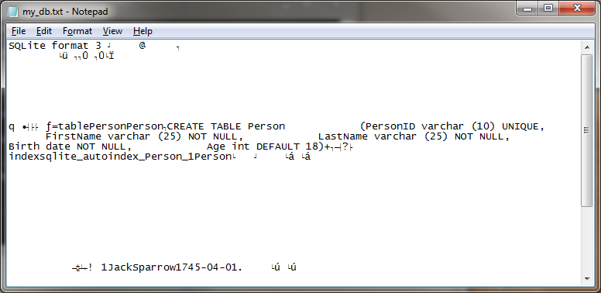
Python & SQL
We didn’t commit the data, so the transactions weren’t saved!
After an INSERT, DELETE, or UPDATE, we must commit the data!!
db_con.commit()

Slide 13
Python & SQL (so far)
import sqlite3
def createPersonTable(cursor):
SQL = """CREATE TABLE Person
(PersonID varchar (10) UNIQUE,
FirstName varchar (25) NOT NULL,
LastName varchar (25) NOT NULL,
Birth date NOT NULL,
Age int DEFAULT 18);"""
cursor.execute(SQL)
def insertPerson(cursor, id_num, fname, lname, bdate, age=18):
SQL = "INSERT INTO Person (PersonID, FirstName, LastName, Birth, Age)"
SQL += "VALUES ('" + str(id_num) + "', '" + fname + "', '" + lname + "', '"
SQL += bdate + "', " + str(age) + ");"
cursor.execute(SQL)
db_con = sqlite3.connect("my_db.txt")
cursor = db_con.cursor()
#createPersonTable(cursor)
insertPerson(cursor, 1, 'Jack', 'Sparrow', '1745-04-01', 46)
db_con.commit()
cursor.execute("SELECT * FROM Person;")
results = cursor.fetchall()
for row in results:
print row

Slide 14
Python & SQL
The query "SHOW TABLES;" doesn’t work in sqlite3.
The equivalent is "SELECT name FROM sqlite_master WHERE type='table';"

Slide 15
Duplicate (Group Work)
Duplicate the data from the Person and House tables online into your local DB file. To do this:
Write a function for creating the House table, and functions for inserting records into both tables
Write a loop that runs until the user tells it to stop. The loop should print out the names of the current tables, then prompt the user for which table they want to insert data into, then prompt them for the entry for each field. It should then call the function that inserts the record
After the loop, show the contents of both tables

Slide 16
Duplicate (Solution pt 1)
import sqlite3
def createPersonTable(cursor):
SQL = """CREATE TABLE Person
(PersonID varchar (10) UNIQUE,
FirstName varchar (25) NOT NULL,
LastName varchar (25) NOT NULL,
Birth date NOT NULL,
Age int DEFAULT 18);"""
cursor.execute(SQL)
def createHouseTable(cursor):
SQL = """CREATE TABLE House
(HouseID varchar (10) UNIQUE,
City varchar (25) NOT NULL,
Value int DEFAULT 100000,
Owner varchar (10));"""
cursor.execute(SQL)
def insertPerson(cursor, id_num, fname, lname, bdate, age=18):
SQL = "INSERT INTO Person (PersonID, FirstName, LastName, Birth, Age)"
SQL += "VALUES ('" + str(id_num) + "', '" + fname + "', '" + lname + "', '"
SQL += bdate + "', " + str(age) + ");"
cursor.execute(SQL)
def insertHouse(cursor, id_num, cit, own, val=100000):
SQL = "INSERT INTO House (HouseID, City, Value, Owner)"
SQL += "VALUES ('" + str(id_num) + "', '" + cit + "', '" + str(val) + "', '"
SQL += own + "');"
cursor.execute(SQL)
def show_table(cursor, table_name):
print "Contents of the", table_name, "Table:"
cursor.execute("SELECT * FROM " + table_name + ";")
results = cursor.fetchall()
for row in results:
print row
print

Slide 17
Duplicate (Solution pt 2)
db_con = sqlite3.connect("my_db.txt")
cursor = db_con.cursor()
#createPersonTable(cursor)
#createHouseTable(cursor)
#insertPerson(cursor, 1, 'Jack', 'Sparrow', '1745-04-01', 46)
#db_con.commit()
while True:
cursor.execute("SELECT name FROM sqlite_master WHERE type='table';")
results = cursor.fetchall()
print "Available Tables:"
for row in results:
print row[0], "\t",
print
choice = raw_input("Insert into which Table (or Enter to stop): ").lower()
if not choice:
print
break
if choice == 'house':
hid = raw_input("Please enter a HouseID (varchar 10): ")
city = raw_input("Please enter a City (varchar 25): ")
value = int(raw_input("Please enter a Value (int): "))
owner = raw_input("Please enter an Owner (varchar 10): ")
insertHouse(cursor, hid, city, owner, value)
db_con.commit()
print "House added.\n“
elif choice == 'person':
pid = raw_input("Please enter a PersonID (varchar 10): ")
first = raw_input("Please enter a FirstName (varchar 25): ")
last = raw_input("Please enter a LastName (varchar 25): ")
birth = raw_input("Please enter a Birth (date) (year-mm-dd): ")
years_old = int(raw_input("Please enter an Age (int): "))
insertPerson(cursor, pid, first, last, birth, years_old)
db_con.commit()
print "Person added.\n“
else:
print "That table does not exist.\n"
show_table(cursor, "Person")
show_table(cursor, "House")

Slide 18
Connecting to MySQL
We’ll be using the MySQLdb module
#! /usr/bin/env python
print 'Content-type: text/html\n'
import MySQLdb
This is an additional module installed on the servers, so you won’t be able to do this import on other machines.

Slide 19
Connecting to MySQL
Save this as sql_test.cgi, copy it into your cgi-pub, and make sure you don’t get any errors from accessing it online:
#! /usr/bin/env python
print 'Content-type: text/html\n'
import MySQLdb
string = "i211u14_username" #change username to yours
password = "my+sql=i211u14_username" #change username to yours
db_con = MySQLdb.connect(host="burrow.soic.indiana.edu", port = 3306, user=string, passwd=password, db=string)
cursor = db_con.cursor()
print 'Connection Successful!'

Slide 20
SQL and Errors
If your SQL Statements have errors or can’t be executed, an exception will be thrown
We need to be sure to catch it or we may not know what happened, and the page will crash.
If there’s no error, there will be no automatic response to executing an SQL statement.

Slide 21
Sample Script showperson.cgi
#! /usr/bin/env python
print 'Content-type: text/html\n'
import MySQLdb
string = "i211u14_username" #change this to yours
password = "my+sql=i211u14_username" #change this to yours
db_con = MySQLdb.connect(host="burrow.soic.indiana.edu", port = 3306, user=string, passwd=password, db=string)
cursor = db_con.cursor()
try: #Always surround .execute with a try!
SQL = "SELECT * FROM Person;"
cursor.execute(SQL)
results = cursor.fetchall()
except Exception, e: #Here we handle the error
print '<p>Something went wrong with the SQL!</p>'
print SQL, "Error:", e
else: #This runs if there was no error
for row in results:
print row, '<br />'

Slide 22
Show an Error showperson.cgi
#! /usr/bin/env python
print 'Content-type: text/html\n'
import MySQLdb
string = "i211u14_username" #change this to yours
password = "my+sql=i211u14_username" #change this to yours
db_con = MySQLdb.connect(host="burrow.soic.indiana.edu", port = 3306, user=string, passwd=password, db=string)
cursor = db_con.cursor()
try: #Always surround .execute with a try!
SQL = "SELECT * FROM Pearson;"
cursor.execute(SQL)
results = cursor.fetchall()
except Exception, e: #Here we handle the error
print '<p>Something went wrong with the SQL!</p>'
print SQL, "Error:", e
else: #This runs if there was no error
for row in results:
print row, '<br />'

Slide 23
Getting Results
Once we’ve successfully executed a query, we get the results from the cursor object
fetchall() – returns all the results as a list of formatted tuples
fetchone() – returns a single tuple with the next result
Tuples will have N elements, where N is the number of columns in the SELECT statement.

Slide 24
Getting Results
If the record set is enormous, running fetchall() could crash the script. In that case, you can use fetchone() in a loop like this:
try:
SQL = "SELECT * FROM Person;"
cursor.execute(SQL)
result = cursor.fetchone()
else:
while result: #this pulls results one at a time
print result, '<br />'
result = cursor.fetchone()

Slide 25
Getting Results
fetchone() is also useful if you only want the ‘first’ result
You can call fetchone() a few times, then fetchall() to get any remaining results in the record set

Slide 26
Keeping Results
You can only call fetchall() or fetchone() once on any given result (either all records or a single record)
After that the cursor has moved along
If you need to keep the results around for later use, you’ll have to re-run the query or store the results in a variable, like a list.

Slide 27
Committing Transactions
Just like sqlite3, MySQLdb uses transactions
This doesn’t affect SELECT statements
But if you do an UPDATE, INSERT, or DELETE you need to do a .commit() to make the changes ‘permanent’
db_con.commit()

Slide 28
Debugging CGI and MySQL
Because of these environments, debugging can be difficult. Use try a lot, it helps!
To see the errors generated by cgi scripts, you can ssh (using PuTTY or SSH client) into:
cgi.soic.indiana.edu
Once logged in, you can run this command to get a live stream of the errors generated by scripts:
tail –f /var/log/httpd/error_log

Slide 29
Debugging CGI and MySQL
Alternately, when you’re logged into burrow, go into your cgi-pub folder and type: python name_of_script.cgi
This tells the version of python on the server to parse your script, and should generate any Python errors in a more visible format.

Slide 30
Tips and Tricks
If you want to store information in a form that you’ll need when it’s submitted, and you don’t want to show it to the user, there’s an input type called hidden:
<input type=“hidden” name=“id” value=“6”>
When the form is submitted, it will have a field called id with a value of 6, even though the user didn’t see this field.
If the form was created by Python printing out HTML, then the number in the value attribute can be anything you want it to be…

Slide 31
Tips and Tricks
If you want to make sure you don’t use an ID # that’s already in use when you INSERT a record into a table, there are two things you can do:
You can define the ID # (when you create the table) to be AUTO_INCREMENT (see: http://www.tutorialspoint.com/mysql/mysql-create-tables.htm)
You can figure out the largest ID # currently in use, and add 1 to it.

Slide 32
Tips and Tricks
When you’re building an SQL statement for the first time, don’t execute it. Print the SQL string out, load the page, make sure it looks valid, then try to execute it.
When I’m testing code, I always leave the SQL printing out in addition to executing so that I know what just ran.
Make sure you print something out if the SQL statement succeeded.

Slide 33
HTML Table Tips
If you want to make a row of headers, use <th></th> instead of <td></td>. This makes them centered and bolded.
If you want to center-align a data cell, try this:
<td align='center'></td>
If you want your table to be wider, try this:
<table border='1' width='400'>

Slide 34
Person Table (Group Work)
Create a .cgi page that prints out all of the rows in your Person table as an HTML table.
Include a row of headers with the name of each field, and center the data as well.
This should look like:
http://cgi.soic.indiana.edu/~johfdunc/person_list.cgi

Slide 35
Person Table (Solution)
#! /usr/bin/env python
print 'Content-type: text/html\n'
import MySQLdb
string = "i211u14_username" #change this to yours
password = "my+sql=i211u14_username" #change this to yours
db_con = MySQLdb.connect(host="burrow.soic.indiana.edu", port = 3306, user=string, passwd=password, db=string)
cursor = db_con.cursor()
try: #Always surround .execute with a try!
SQL = "SELECT * FROM Person;"
cursor.execute(SQL)
results = cursor.fetchall()
except Exception, e: #Here we handle the error
print '<p>Something went wrong with the SQL!</p>'
print SQL
print "\nError:", e
else: #This runs if there was no error
print "<html><body><table border='1' width='30%'>"
print "<tr><th>PersonID</th><th>FirstName</th><th>LastName</th><th>Birth</th><th>Age</th></tr>"
for row in results:
print "<tr>"
for entry in row:
print "<td align='center'>", entry, "</td>"
print "</tr>"
print "</table></body></html>"

Slide 36
Questions?

